Slide 1
Access Control Lists

Slide 2
Access Control Lists
On a Cisco router, one can configure a simple firewall for basic traffic filtering capabilities using ACLs.
ACLs can be used to stop traffic or permit only specified traffic on networks.
ACLs on a Cisco router are part of any security solution.

Slide 3
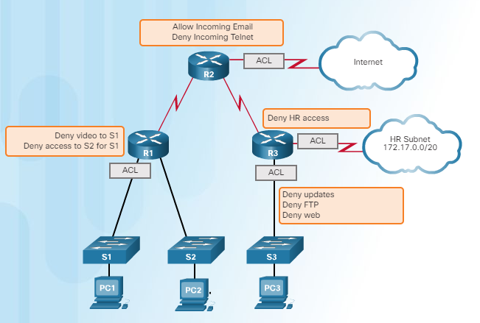
ACLs
An ACL is a series of IOS commands that control whether a router forwards or drops packets based on information found in the packet header.
ACLs are among the most commonly used features of Cisco IOS software.
When configured, ACLs perform the following tasks:
Limit network traffic to increase network performance.
Provide traffic flow control
Provide a basic level of security for network access.
Filter traffic based on traffic type.
Screen hosts to permit or deny access to network services.
By default, a router does not have ACLs configured; therefore, by default a router does not filter traffic.

Slide 4
Packet Filtering
An ACL is a sequential list of permit or deny statements, known as access control entries (ACEs).
This process is called packet filtering: Packet filtering controls access to a network by analyzing the incoming and outgoing packets and forwarding them or discarding them based on given criteria.
Packet filtering can occur at Layer 3 or Layer 4:
Standard ACLs only filter at Layer 3.
Extended ACLs filter at Layer 3 and Layer 4.
The source IPv4 address is the filtering criteria set in each ACE of a standard IPv4 ACL.
The last statement of an ACL is always an implicit deny.
Notes:
When network traffic passes through an interface configured with an ACL, the router compares the information within the packet against each ACE, in sequential order, to determine if the packet matches one of the ACEs.
A router configured with a standard IPv4 ACL extracts the source IPv4 address from the packet header.

Slide 5
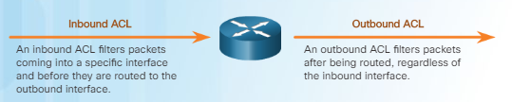
Inbound and Outbound ACLs
ACLs can be configured to apply to inbound traffic and outbound traffic as shown in the illustration below.
Inbound ACLs - Incoming packets are processed before they are routed to the outbound interface.
Inbound ACLs are best used to filter packets when the network attached to an inbound interface is the only source of packets that need to be examined.
Outbound ACLs - Incoming packets are routed to the outbound interface, and then they are processed through the outbound ACL.
Outbound ACLs are best used when the same filter will be applied to packets coming from multiple inbound interfaces before exiting the same outbound interface.
Notes:
ACLs do not act on packets that originate from the router itself.
ACLs define the set of rules that give added control for packets that enter inbound interfaces, packets that relay through the router, and packets that exit outbound interfaces of the router.
An inbound ACL is efficient because it saves the overhead of routing lookups if the packet is discarded. If the packet is permitted by the ACL, it is then processed for routing.

Slide 6
Wildcard Masking
A wildcard mask is a string of 32 binary digits used by the router to determine which bits of the address to examine for a match.
Wildcard masks use binary 1s and 0s to filter individual IPv4 addresses or groups of IPv4 addresses to permit or deny access to resources.
Wildcard masks use the following rules to match binary 1s and 0s:
Wildcard mask bit 0 - Match the corresponding bit value in the address.
Wildcard mask bit 1 - Ignore the corresponding bit value in the address.
Notes:
IPv4 ACEs include the use of wildcard masks.
As with subnet masks, the numbers 1 and 0 in the wildcard mask identify how to treat the corresponding IPv4 address bits. However, in a wildcard mask, these bits are used for different purposes and follow different rules.
Subnet masks use binary 1s and 0s to identify the network, subnet, and host portion of an IPv4 address. Wildcard masks use binary 1s and 0s to filter individual IPv4 addresses or groups of IPv4 addresses to permit or deny access to resources.
Wildcard masks and subnet masks differ in the way they match binary 1s and 0s.
Wildcard masks are often referred to as an inverse mask. The reason is that, unlike a subnet mask in which binary 1 is equal to a match and binary 0 is not a match, in a wildcard mask the reverse is true.
Note: Unlike IPv4 ACLs, IPv6 ACLs do not use wildcard masks. Instead, the prefix-length is used to indicate how much of an IPv6 source or destination address should be matched. IPv6 ACLs are not covered here

Slide 7
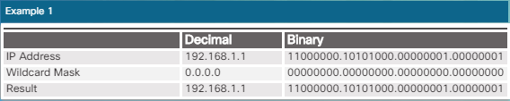
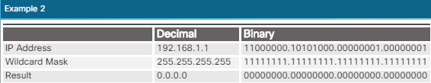
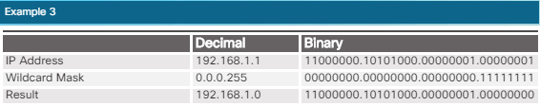
Wildcard Masks - Examples
Notes:
In the first example the wildcard mask stipulates that every bit in the IPv4 192.168.1.1 must match exactly.
In the second example, the wildcard mask stipulates that anything will match.
In the third example, the wildcard mask stipulates that any host within the 192.168.1.0/24 network will match.

Slide 8
Wildcard key words: host and any
The keywords host and any help identify the most common uses of wildcard masking.
The host keyword substitutes for the 0.0.0.0 mask: this mask states that all IPv4 address bits must match to filter just one host address.
The any option substitutes for the IPv4 address and 255.255.255.255 mask: this mask says to ignore the entire IPv4 address or to accept any addresses.
Wildcard + host /any + permit / deny: determine the behaviour of the ACE.

Slide 9
Creating ACLs
One ACL per protocol (IPv4 and IPv6)- To control traffic flow on an interface, an ACL must be defined for each protocol enabled on the interface.
One ACL per direction (in and out) - ACLs control traffic in one direction at a time on an interface: two separate ACLs must be created to control inbound and outbound traffic.
One ACL per interface - ACLs control traffic for an interface.

Slide 10
Numbered Standard IPv4 ACL Syntax: Create an ACL
Create the standard ACL; and then activate the ACL on an interface
The access-list global configuration command defines a standard ACL with a number in the range of 1 through 99 (but see embedded comments).
Syntax: Router(config)# access-list access-list-number { deny | permit | remark } source [ source-wildcard ][ log ]
Example: R1(config)# access-list 10 permit host 192.168.10.10
Notes:
Cisco IOS Software Release 12.0.1 extended these numbers by allowing 1300 to 1999 to be used for standard ACLs. This allows for a maximum of 798 possible standard ACLs. These additional numbers are referred to as expanded IPv4 ACLs.
The remark keyword is used for documentation and makes access lists a great deal easier to understand.
The log option causes packets that match the ACE to be logged (generates syslog messages).

Slide 11
Numbered Standard IPv4 ACL Syntax: Applying ACLs to Interfaces
After a standard IPv4 ACL is configured, it is linked to an interface using the ip access-group command in interface configuration mode:
Router(config-if)# ip access-group { access-list-number | access-list-name } { in | out }
Notes:
To remove an ACL from an interface, first enter the no ip access-group command on the interface, and then enter the global no access-list command to remove the entire ACL.
Recall that there is an implicit deny all statement that is equivalent to adding the line access-list 1 deny 0.0.0.0 255.255.255.255 or access-list deny any to the end of the ACL.

Slide 12
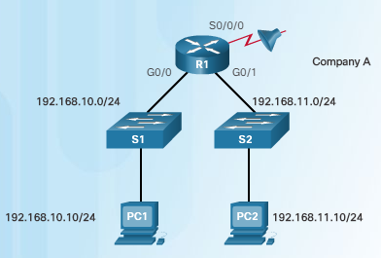

Example 1:
An example of an ACL that permits a specific subnet except for a specific host on that subnet.
The first command deletes the previous version of ACL 1 (assuming there was one).
The next ACL statement, denies the PC1 host located at 192.168.10.10.
Every other host on the 192.168.10.0/24 network is then permitted.
Again the implicit deny statement matches every other network.
The ACL is reapplied to interface S0/0/0 in an outbound direction.

Slide 13
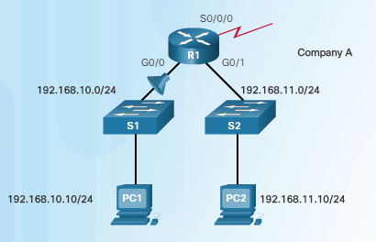

Example 2:
Block traffic from host PC1 but permits all other traffic.
The ACL is applied to interface G0/0 in the inbound direction.
The filter only affects the 192.168.10.0/24 LAN on G0/0: it is more efficient to apply the ACL to the inbound interface.
Notes:
This example still blocks traffic from host PC1 but permits all other traffic.
The first two commands are the same as the previous example. The first command deletes the previous version of ACL 1 and the next ACL statement denies the PC1 host that is located at 192.168.10.10.
The third line is new and permits all other hosts. This means that all hosts from the 192.168.10.0/24 network will be permitted except for PC1, which was denied in the previous statement.
This ACL is applied to interface G0/0 in the inbound direction. Because the filter only affects the 192.168.10.0/24 LAN on G0/0 it is more efficient to apply the ACL to the inbound interface. The ACL could be applied to S0/0/0 in the outbound direction but then R1 would have to examine packets from all networks including 192.168.11.0/24.

Slide 14
Named Standard IPv4 ACL Syntax
Naming an ACL makes it easier to understand its function.
Syntax to identify an ACL with a name instead of a number: slightly different.
Notes:
Step 1. Starting from the global configuration mode, use the ip access-list command to create a named ACL. ACL names are alphanumeric, case sensitive, and must be unique. The ip access-list standard name command is used to create a standard named ACL. After entering the command, the router is in standard (std) named ACL (nacl) configuration mode.
Note: Numbered ACLs use the global configuration command access-list, whereas named IPv4 ACLs use the ip access-list command.
Step 2. From the named ACL configuration mode, use permit or deny statements to specify one or more conditions for determining whether a packet is forwarded or dropped. You can use remark to add a comment to the ACL.
Step 3. Apply the ACL to an interface using the ip access-group name command. Specify whether the ACL should be applied to packets as they enter the interface (in) or applied to packets as they exit the interface (out).

Slide 15
Verifying ACLs
show ip interface can beused to verify the ACL on the interface.
show access-lists followed by the access list number or name can be used to view an individual access list.

Slide 16
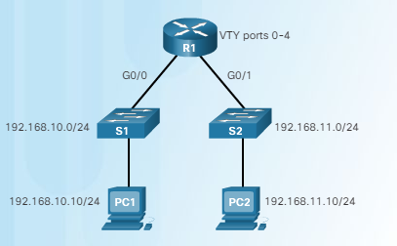
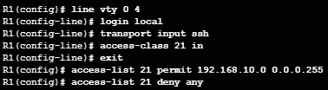
The access-class Command
Security of administrative lines can be improved by restricting VTY access.
The command syntax of the access-class command is:
Router(config-line)# access-class access-list-number { in | out }
Notes:
Restricting VTY access is a technique that allows to define which IP addresses are allowed remote access to the router EXEC process. One can specify which IP addresses are allowed remote access to your router with an ACL and an access-class statement configured on VTY lines. This is used with SSH to further improve administrative access security.
The access-class command configured in line configuration mode restricts incoming and outgoing connections between a particular VTY (into a Cisco device) and the addresses in an access list.
The parameter in restricts incoming connections between the addresses in the access list and the Cisco device, while the parameter out restricts outgoing connections between a particular Cisco device and the addresses in the access list.
The ACL in the figure is configured to permit network 192.168.10.0 to access VTY lines 0 - 4 but deny all other networks.
The following should be considered when configuring access lists on VTYs:
Both named and numbered access lists can be applied to VTYs.
Identical restrictions should be set on all the VTYs, because a user can attempt to connect to any of them.
Note: Access lists apply to packets that travel through a router. They are not designed to block packets that originate within the router. By default, an outbound ACL does not prevent remote access connections initiated from the router.

